Slide 1
Analysis for Data Science Job Salaries
Kevin Chou
(https://www.kaggle.com/datasets/ruchi798/data-science-job-salaries)

Slide 2
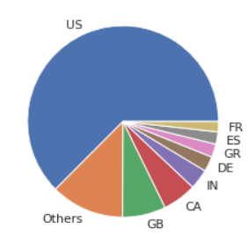
Data processing
1. Gather the newest data(year of 2022)
2. View the pie chart of jobs, we can see that
most of them are in the US, so the currency
will be in USD
3. View job titles
['Data Engineer' 'Data Analyst' 'Data Scientist' 'Head of Data Science'
'Analytics Engineer' 'Data Science Manager' 'Data Architect'
'Machine Learning Engineer' 'ETL Developer' 'Lead Data Engineer’…]
4.Get the top 10 job titles based on count.

Slide 3
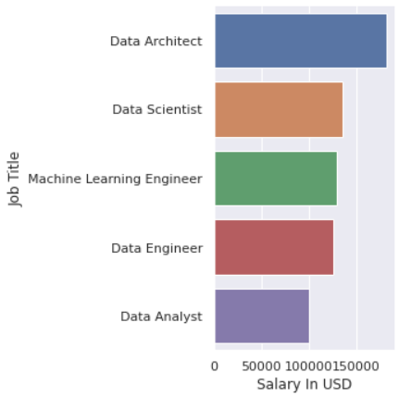
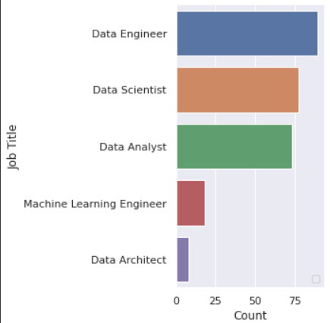
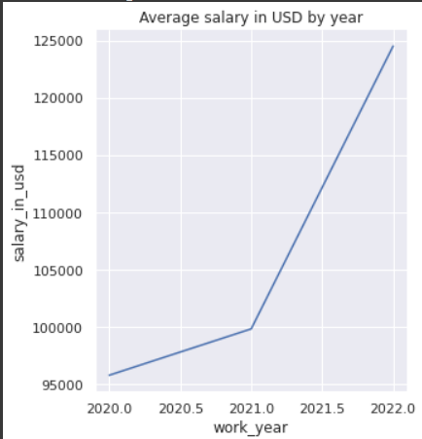
Result
Top 5 common job title in 2022 and their pay
Data Engineer
Data Scientist
Data Analyst
Machine Learning Engineer
Data Architect
We can also see from the chart that the average salary is increasing by year.

Slide 4
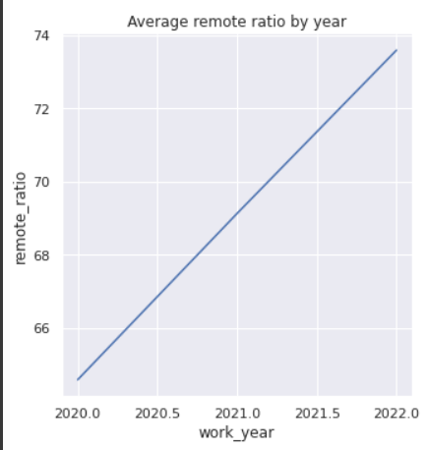
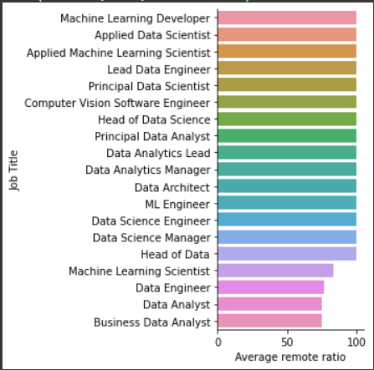
Remote ratio
We can see by chart what job title allows their employees to work remotely the most on average.
We can also tell by the chart, the Data Science field is a field that allows their employs to work remotely.

